Slide 1
Recommendation in Social Media
Social Media Mining

Slide 2
Difficulties of Making Decision
Which digital camera should I buy?
Where should I spend my holiday?
Which movie should I rent?
Whom should I follow?
Where should I find interesting news article?
Which movie is the best for our family?
If interested, see two recent conference tutorials
SIGKDD2014, Recommendation in Social Media
RecSys2014, Personalized Location Recommendation
Notes:
http://www.public.asu.edu/~jtang20/Recommendation.htm
http://www.public.asu.edu/~hgao16/recsys2014.html

Slide 3
When Does This Problem Occur?
There are many choices
There are no obvious advantages among them
We do not have enough resources to check all options (information overload)
We do not have enough knowledge and experience to choose, or
I’m lazy, but don’t want to miss out on good stuff
Defensive decision making
Goal of Recommendation:
To come up with a short list of
items that fits user’s interests
Notes:
Choice paralysis

Slide 4
Common Solutions to the Problem
Consulting friends
Obtaining information from a trusted third party
Hiring a team of experts
Search the Internet
Following the crowd (pick the item from top-n lists, e.g., best sellers on Amazon)
Can we automate all of the above?
Using a recommender algorithm (a.k.a. a recommender system)

Slide 5

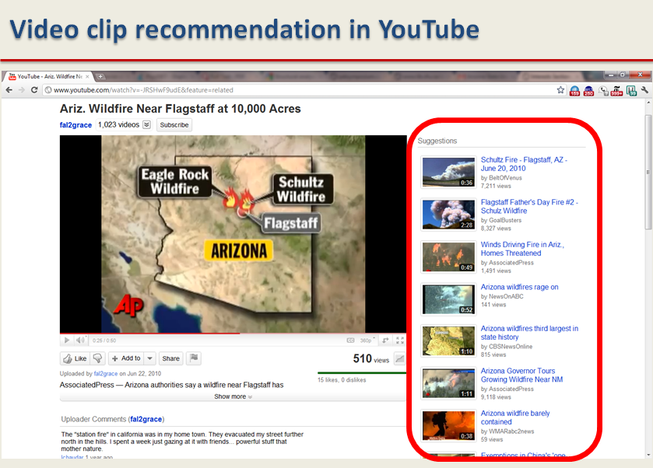
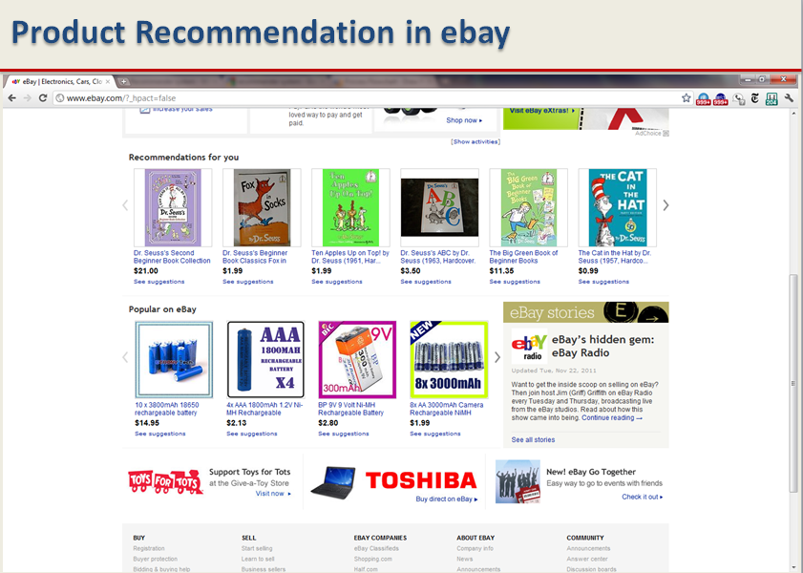
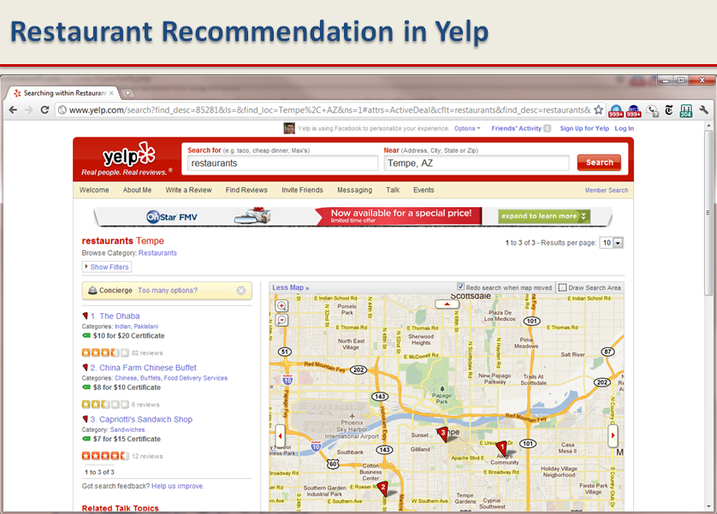
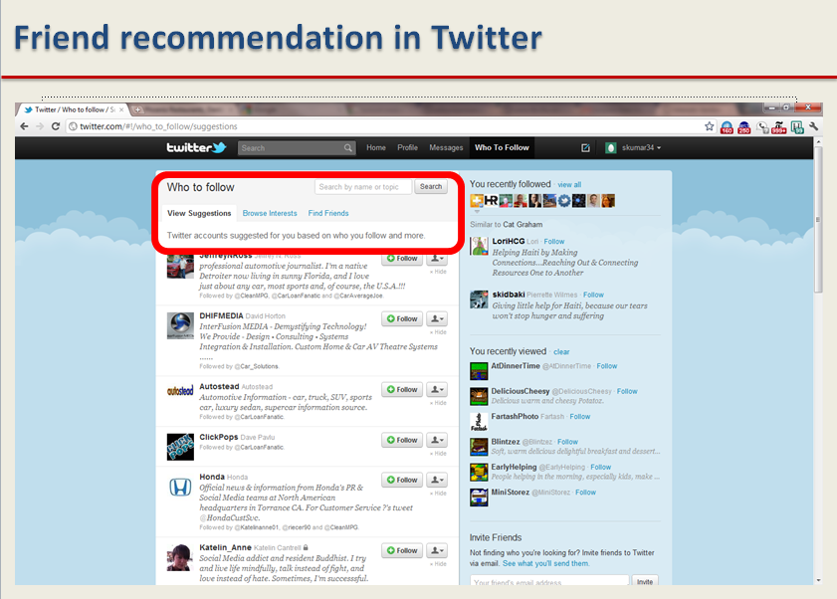
Recommender Systems - Examples

Slide 6
Main Idea behind Recommender Systems
Use historical data such as the user’s past preferences or similar users’ past
preferences to predict future likes
Users’ preferences are likely to remain stable, and change smoothly over time.
By watching the past users’ or groups’ preferences, we try to predict their future likes
Then we can recommend items of interest to them
Formally, a recommender system takes a set of users U and a set of items I and learns a function f such that:

Slide 7
Recommendation vs. Search
One way to get answers is using search engines
Search engines find results that match the query provided by the user
The results are generally provided as a list ordered with respect to the relevance of the item to the given query
Consider the query “best 2014 movie to watch”
The same results for an 8 year old and an adult
Search engines’ results are not customized

Slide 8
Challenges (I)
The Cold Start Problem
Many recommendation systems use historical data or information provided by the user to recommend items, products, etc. However, when individuals join sites, they still haven’t bought any product, or they have no history. This makes it hard to infer what they are going to like when they start on a site. The problem is referred to as the cold-start problem..
Data Sparsity
Similar to the cold-start problem, data sparsity is when not enough historical or prior information is available. Unlike the cold start problem, this is in the system as a whole and is not specific to an individual.

Slide 9
Challenges (II)
Attacks
Push Attack: pushing the ratings up by creating fake users
Nuke attack: DDoS attacks, stop the whole recommendation systems
Privacy
Employing user’s private information to recommend to others.
Explanation
Recommendation systems often recommend items without any explanation of why recommending them

Slide 10
Classical Recommendation Algorithms
Content-based algorithms
Collaborative filtering

Slide 11
Content-Based Methods
Content-based recommendation systems are based on the fact that a user’s interest should match the description of the items that she should be recommended by the system.
In other words, the more similar the item’s description to that of the user’s interest, the more likely that the user finds the item’s recommendation interesting.
Finding the similarity between the user and all of the existing items is the core of this type of recommender systems

Slide 12
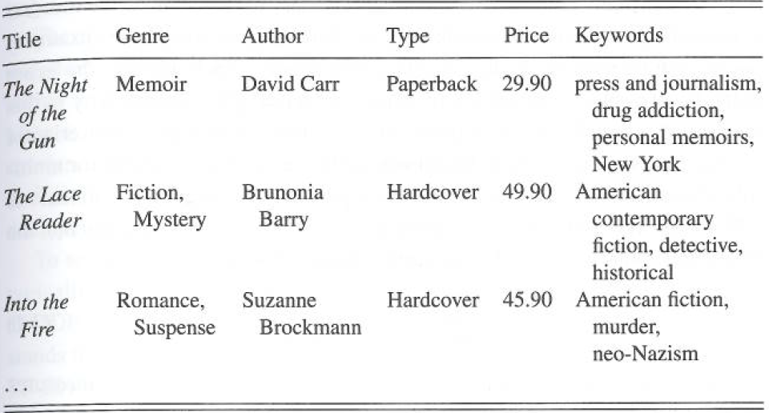
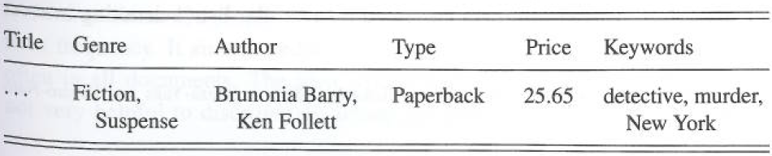
Content-based Recommendation: An Example
Book knowledge base
User Profile

Slide 13
Content-based Recommendation Algorithm
Describe the items to be recommended
Create a profile of the user that describes the types of items the user likes
Compare items with the user profile to determine what to recommend
The profile is often created, and updated automatically in response to feedback on the desirability of items that are presented to the user

Slide 14
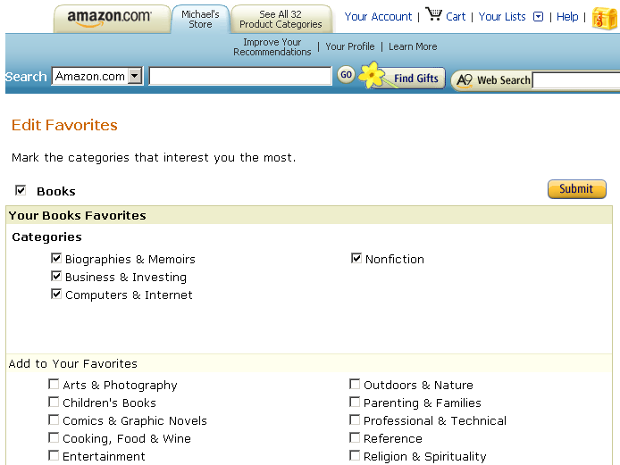
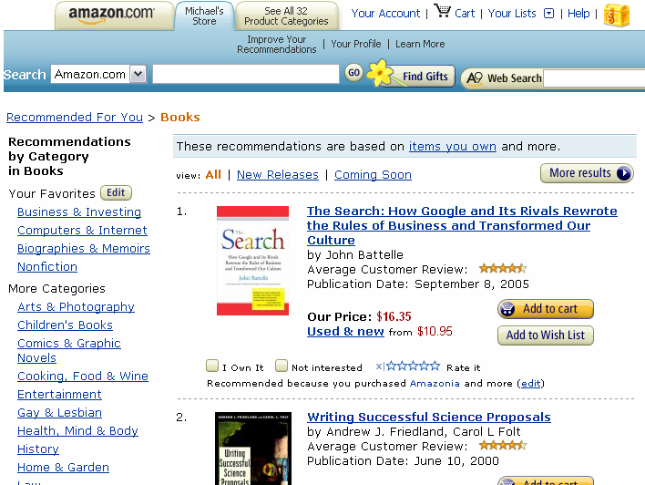
Content-based Recommendation: Example
Notes:
Left panel is user profile (or model), right panel is the recommendation result used the user profile.

Slide 15
Content-Based Methods
To formalize a content-based method, we first represent both user profiles and item descriptions by vectorizing them using a set of k keywords
We can vectorize (e.g., using TF-IDF) both users and items and compute their similarity
We can recommend the top most similar items to the user

Slide 16
Content-Based Recommendation Algorithm
In content-based recommendation, we compute the topmost similar items to a user j and then recommend these items in the order of similarity

Slide 17
Collaborative Filtering
Collaborative filtering is the process of selecting information or patterns using techniques involving collaboration among multiple agents, viewpoints, data sources, etc.
The main advantage of this method is that the recommender system does not need to have additional information about the users or content of the items
Users’ rating or purchase history is the only information that is needed to work

Slide 18
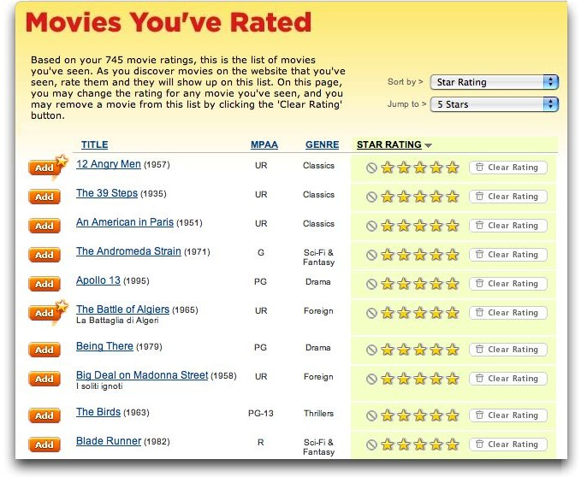
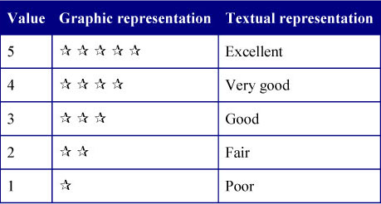
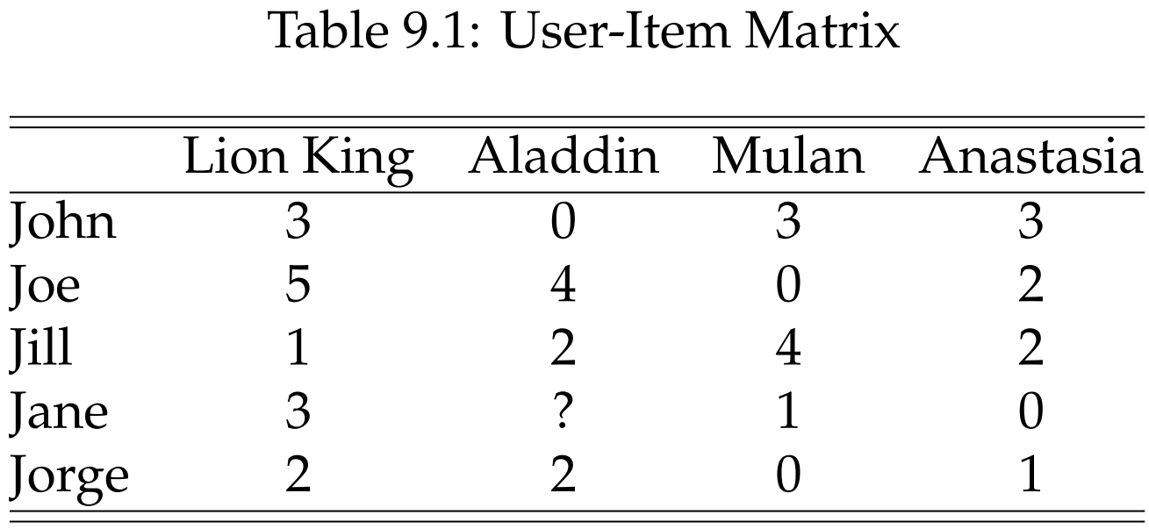
Rating Matrix: An Example

Slide 19
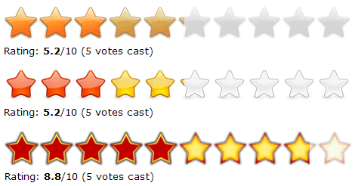
Rating Matrix
Users rate (rank) the items (purchased, watched)
Explicit ratings: entered by a user directly
(i.e., “Please rate this on a scale of 1-5”)
Implicit ratings: inferred from other user behavior
Play lists or music listened to, for a music Rec system
The amount of time users spent on a webpage

Slide 20
Collaborative Filtering
Types of Collaborative Filtering Algorithms:
Memory-based: Recommendation is directly based on previous ratings in the stored matrix that describes user-item relations
Model-based: Alternatively, one can assume that an underlying model (hypothesis) governs the way users rate items. This model can be approximated and learned. The model is then used to recommend ratings. A model, for example, is that users rate low budget movies poorly

Slide 21
Memory-Based Collaborative Filtering
The most important assumptions of collaborative filtering are:
User-based CF
Users with similar previous ratings for items are likely to rate future items similarly
Item-based CF
Items that have received similar ratings previously from users are likely to receive similar ratings from future users (item-based CF)

Slide 22
Collaborative Filtering: Algorithm
Weigh all users/items with respect to their similarity with the current user/item
Select a subset of the users/items (neighbors) as recommenders
Predict the rating of the user for specific items using neighbors’ ratings for the same (or similar) items
Recommend items with the highest predicted rank

Slide 23
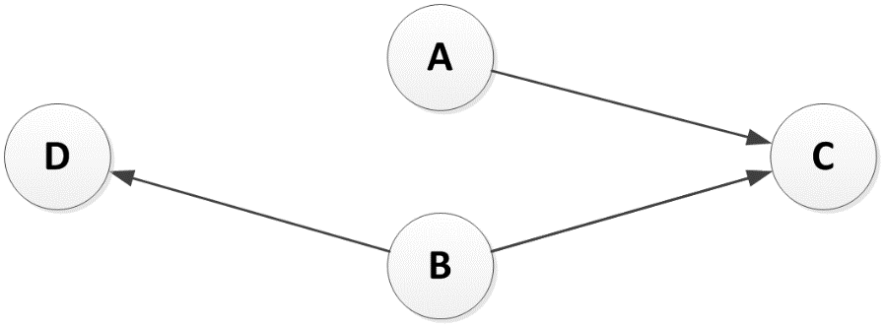
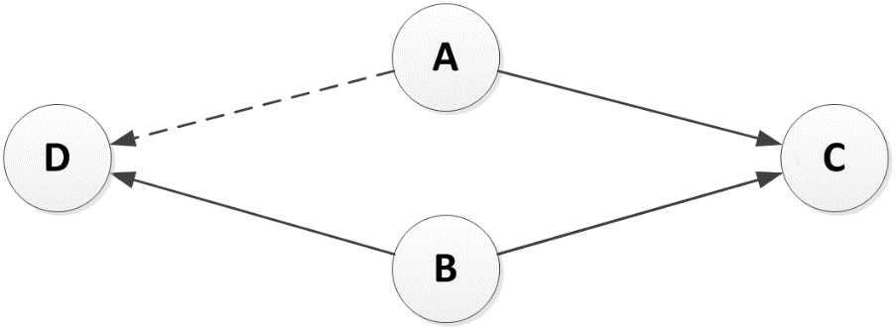
Collaborative Filtering: Illustration
A and B are following C, and B is following D
A might be interested in following D

Slide 24
Measure Similarity between Users (or Items)
Cosine Similarity
Pearson Correlation Coefficient
Notes:
Can we use Jaccard index J(A,B) = |A^B|/|AvB|

Slide 25
User-based Collaborative Filtering
In user-based collaborative filtering, the system finds the most similar user (users) to the current user and uses their preferences for recommendation
The user-based approach is not as popular as the item-based approach
For a system that handles a large user base, even the smallest change in the user data is likely to reset the entire group of similar users

Slide 26
User-based CF
Updating the ratings:
User v’s mean rating
User u‘s mean rating
Observed rating of user v for item i
Predicted rating of user u for item i

Slide 27
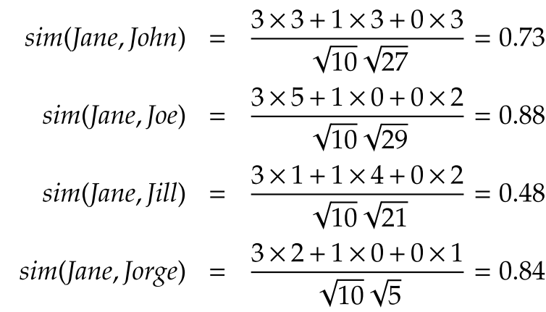
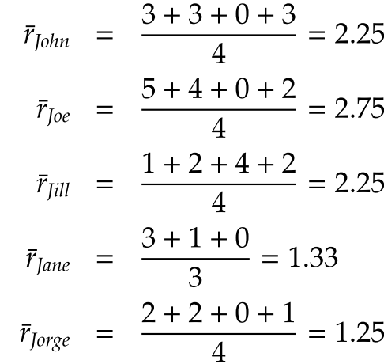
User-based CF, Example
Predict Jane’s rating for Aladdin
1- Calculate average ratings
2- Calculate user-user similarity
Notes:
Predict Jane’s rating for Aladdin

Slide 28
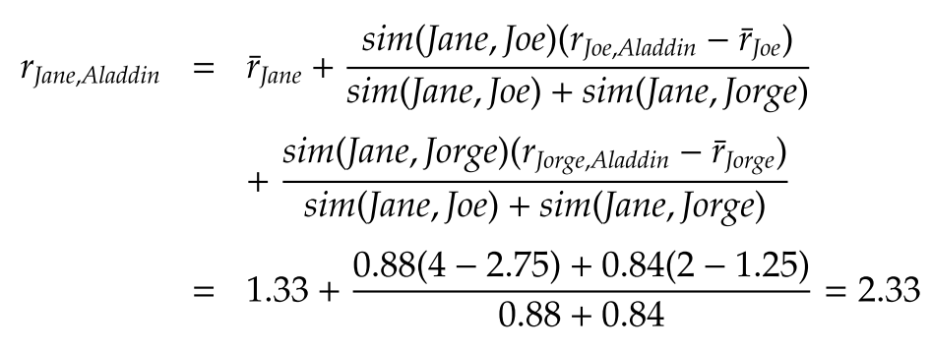
User-based CF, Example- continued
3- Calculate Jane’s rating for Aladdin,
Assume that neighborhood size = 2

Slide 29
Item-based CF
Calculate the similarity between items and then predict new items based on the past ratings for similar items
Item i’s mean rating
i and j are two items

Slide 30
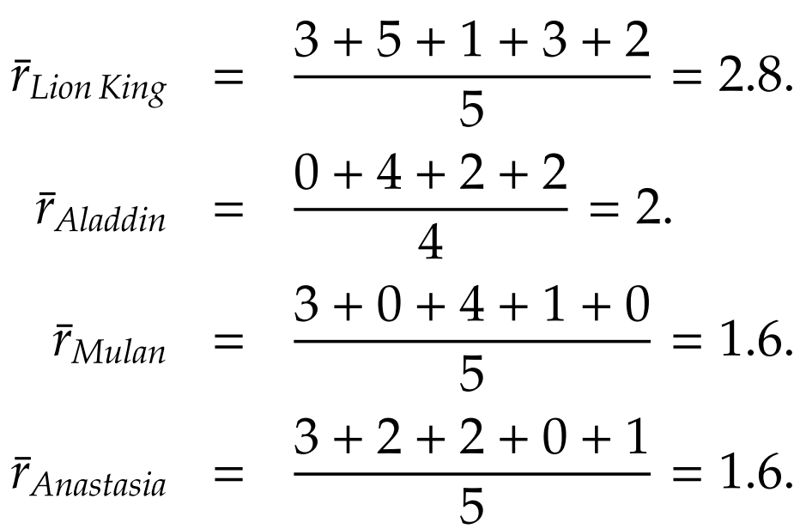
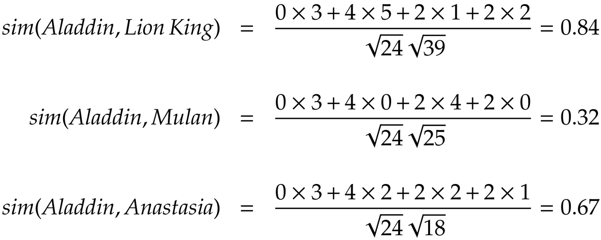
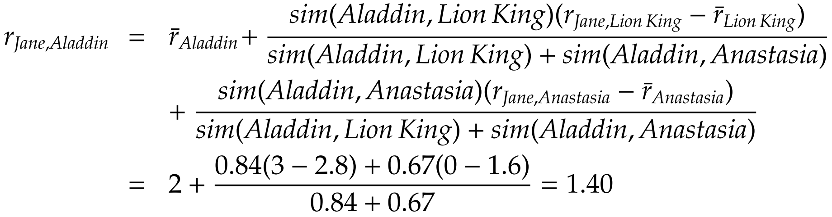
Item-based CF, Example
1- Calculate average ratings
2- Calculate item-item similarity
3- Calculate Jane’s rating for Aladdin, Assume that neighborhood size = 2

Slide 31
Model-Based Collaborative Filtering
In memory-based methods (either item-based or user-based), we aim to predict the missing ratings based on similarities between users or items.
In model-based collaborative ﬁltering, we assume that an underlying model governs the way users rate.
We aim to learn that model and then use that model to predict the missing ratings.
Among a variety of model-based techniques, we focus on a well-established model-based technique that is based on singular value decomposition (SVD).
Notes:
Page 252. k<<min(m,n); Eckart-Young-Mirsky theorem guarantees that C is the best approximation that minimizes Frobenius norm.

Slide 32

Singular Value Decomposition (SVD)
SVD is a linear algebra technique that, given a real matrix X ∈ R^{m×n} , m ≥ n, and factorizes it into three matrices,
where U ∈ R^{m×m} and V ∈ R^{n×n} are orthogonal matrices and Σ ∈ R^{m×n} is a diagonal matrix.
The product of these matrices is equivalent to the original matrix; therefore, no information is lost.

Slide 33
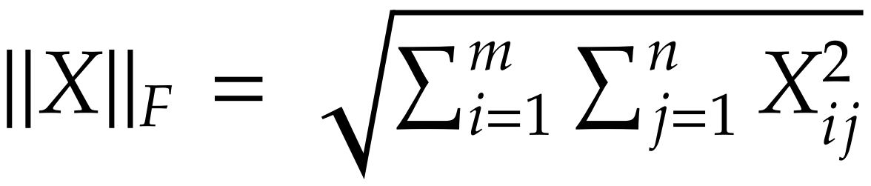
Low-rank Matrix Approximation
A Low-rank matrix approximation of matrix X is another matrix C ∈ R^{m×n}.
C approximates X, and C’s rank (the maximum number of linearly independent columns) is a ﬁxed number k << min(m, n)
Rank(C) = k
The best low-rank matrix approximation is a matrix C that minimizes ||X−C||_{F}
Low-rank approximations of matrices remove noise by assuming that the matrix is not generated at random and has an underlying structure.
SVD can help remove noise by computing a low-rank approximation of a matrix.

Slide 34
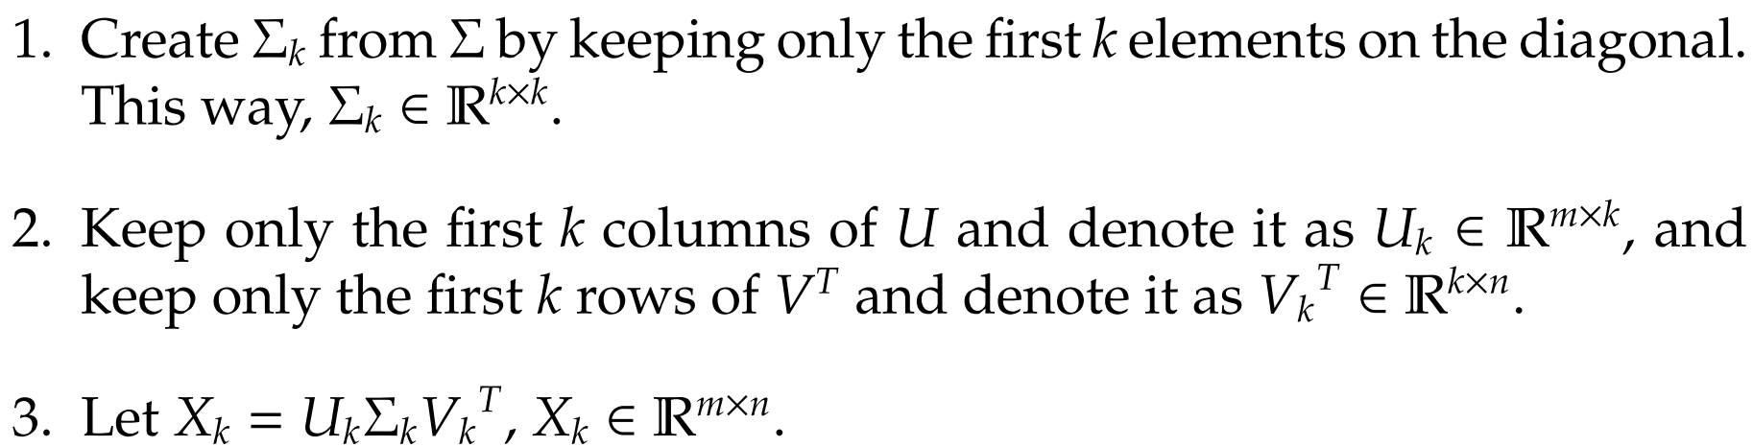
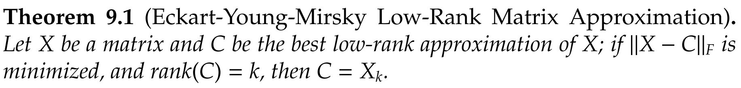
Low-rank Matrix Approximation with SVD
X_{k} is the best low-rank approximation of a matrix X

Slide 35
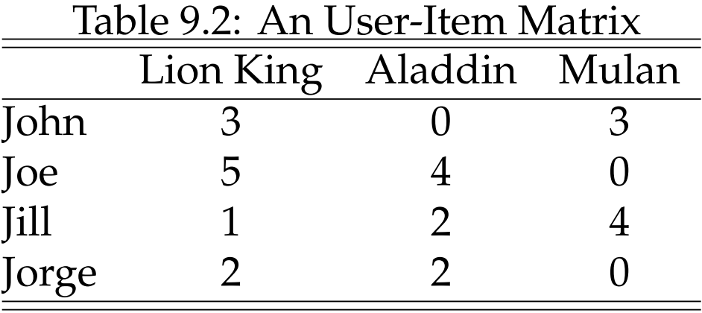
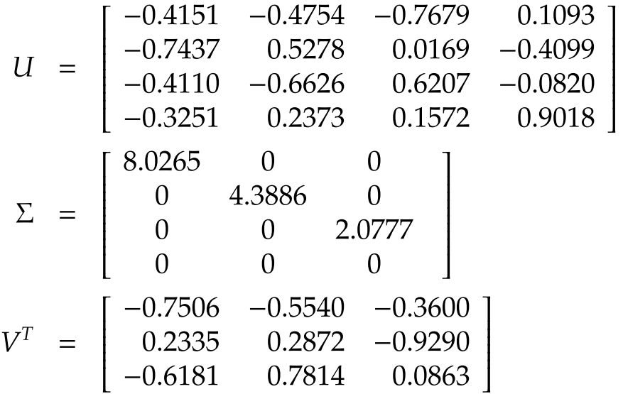
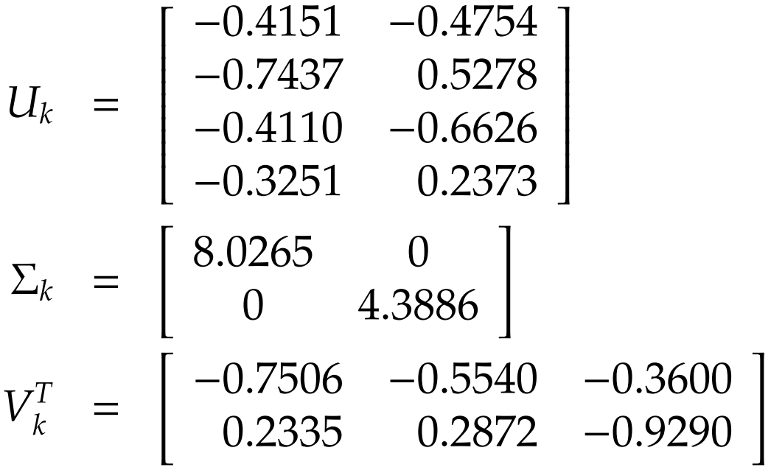
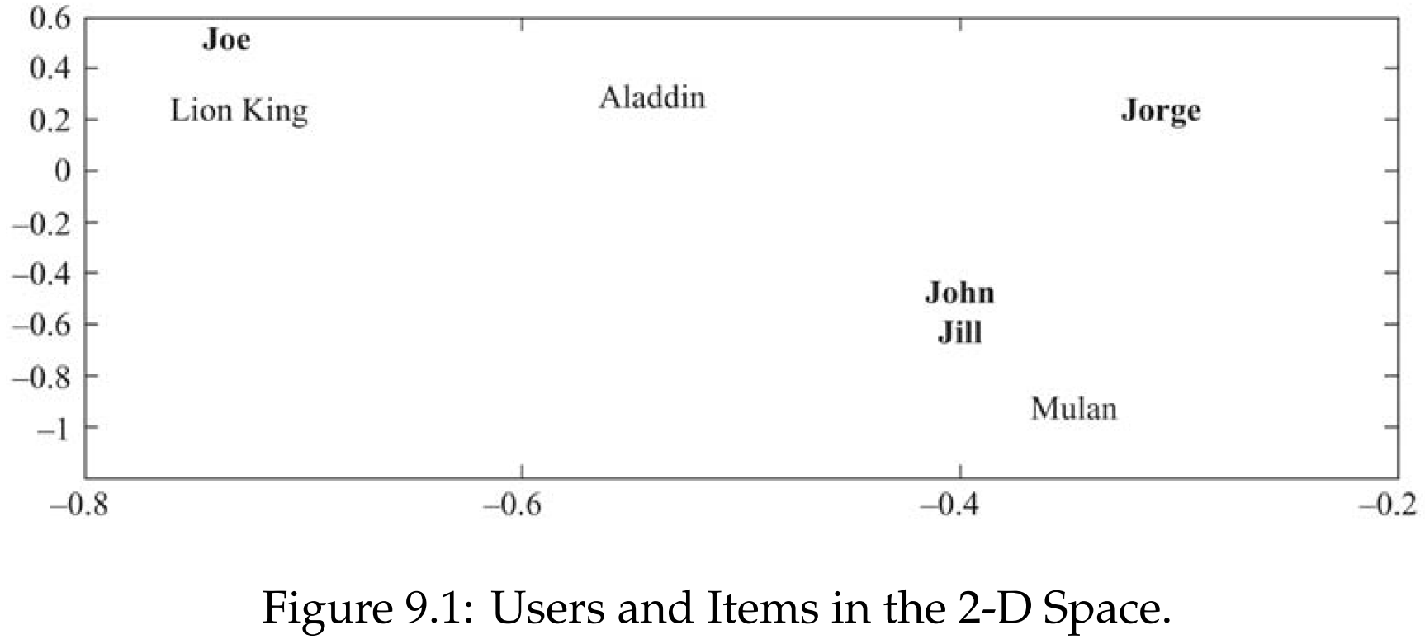
Model-based CF, Example
Considering a rank 2 approximation (i.e., k = 2), we truncate all three matrices:
Notes:
After most similar items or users are found in the lower k-dimensional space, one can follow the same process outlined in user-based or item-based collaborative ﬁltering to ﬁnd the ratings for an unknown item.
For instance, we showed in Example 9.3 (see Figure 9.1) that if we are predicting the rating r_{Jill,Lion} King and assume that neighborhood size is 1, item-based CF uses r_{Jill,Aladdin} , because Aladdin is closest to Lion King. Similarly, user-based collaborative ﬁltering uses r_{John,Lion} King , because John is the closest user to Jill.

Slide 36
Recommendation to a Group

Slide 37
Recommendation to Groups
Find content of interest to all members of a group of socially acquainted individuals
Examples:
A movie for friends to watch together
A travel destination for a family to spend a holiday break
A good restaurant for colleagues to have a working lunch
A music to be played in a public area

Slide 38
Tasks of a Group Recommender System
Acquiring preferences
Generating recommendations
Explaining recommendations
Helping group members to achieve consensus

Slide 39
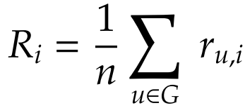
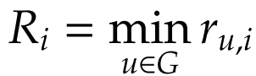
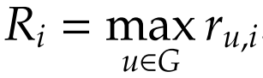
Aggregation Strategies
Maximizing Average Satisfaction
Average everyone’s ratings and choose the max
Least Misery
This approach tries to minimize the dissatisfaction among group’s members (Max of the mins of all)
Most Pleasure
The maximum of individuals’ maximum ratings is taken as group’s rating
Notes:
Non-Preference Aggregation (See the four methods in slide): Max(averages of all), Max(least’s of all), Max(max’s of all)
Preference Aggregation
Merging of recommendations made for individuals
Aggregation of ratings for individuals
Construction of group preference models

Slide 40
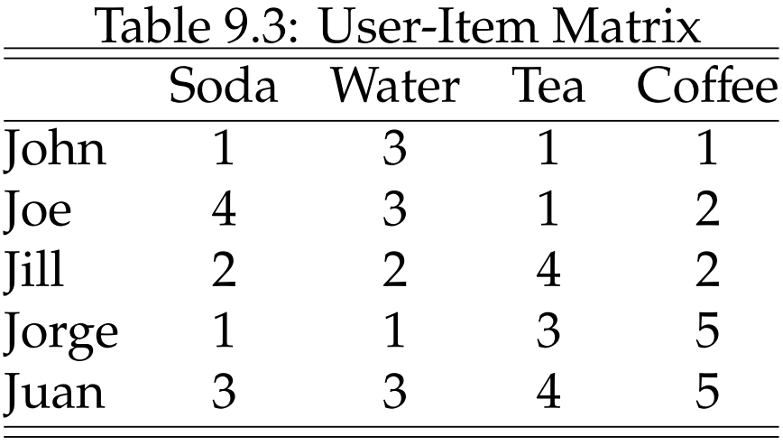
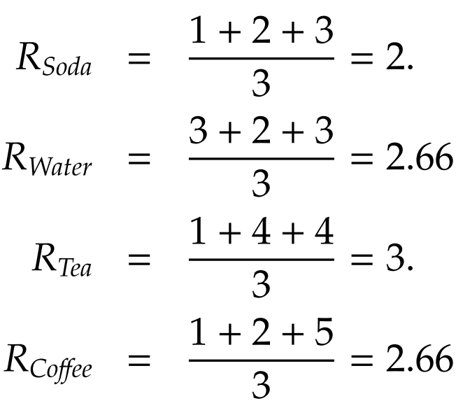
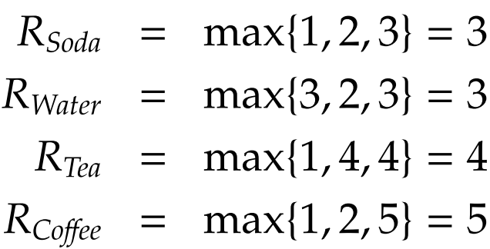
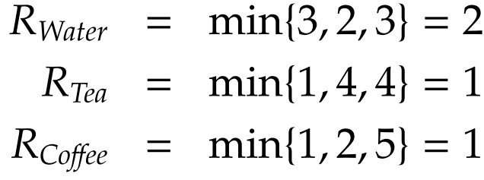
Recommendation to Group, an Example
Average Satisfaction
Least Misery
Most Pleasure
Notes:
Average Satisfaction

Slide 41
Recommendation Using Social Context
Recommendation using social context alone
Extending classical methods with social context
Recommendation constrained by social context

Slide 42
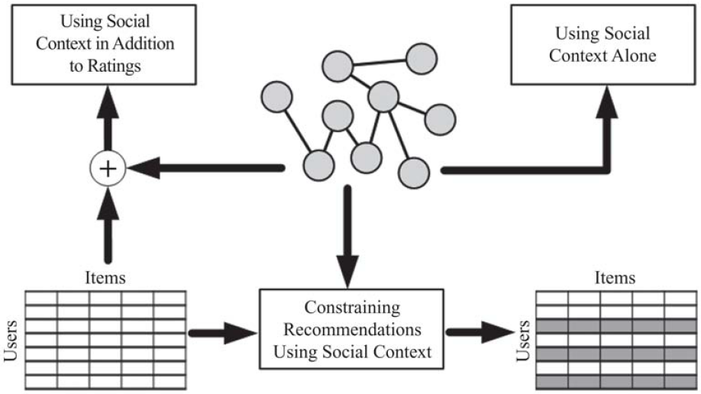
Information Available in Social Context
In social media, in addition to ratings of products, there is additional information available, such as the friendship network among individuals.
This information can be used to improve recommendations, based on the assumption that an individual’s friends have an impact on the ratings ascribed to the individual.
This impact can be due to homophily, inﬂuence, or confounding
Notes:
Recommendation using Social Context. When utilizing social information, we can 1) utilize this information independently, 2) add it to user-rating matrix, or 3) constrain recommendations with it.

Slide 43
Recommendation Using Social Context Alone
Consider a network of friendships for which no user-item rating matrix is provided.
In this network, we can still recommend users from the network to other users for friendship.
This is an example of friend recommendation in social networks.

Slide 44

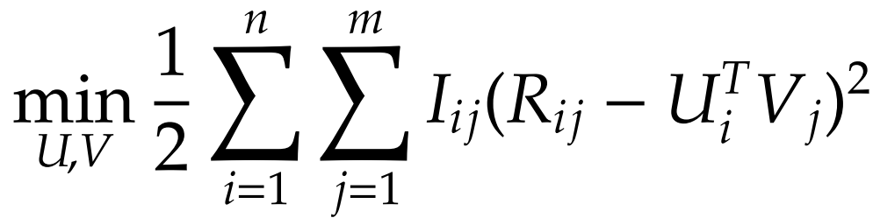
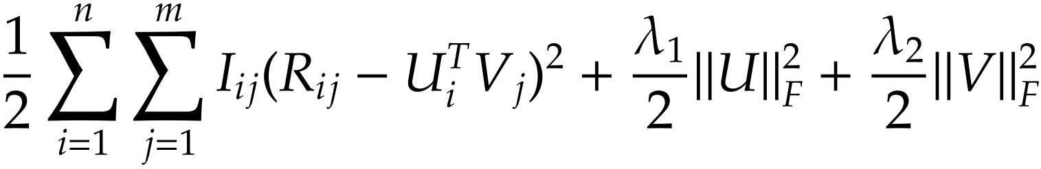
Extending Classical Methods
Social information can be used in addition to a user-item rating matrix to improve recommendation.
Addition of social information can be performed by assuming that users that are connected (i.e., friends) have similar tastes in rating items.
Notes:
R: Rating matrix,
U: New representation for users
Lambda_1 and Lambda_2 are predefined non-negative constants

Slide 45
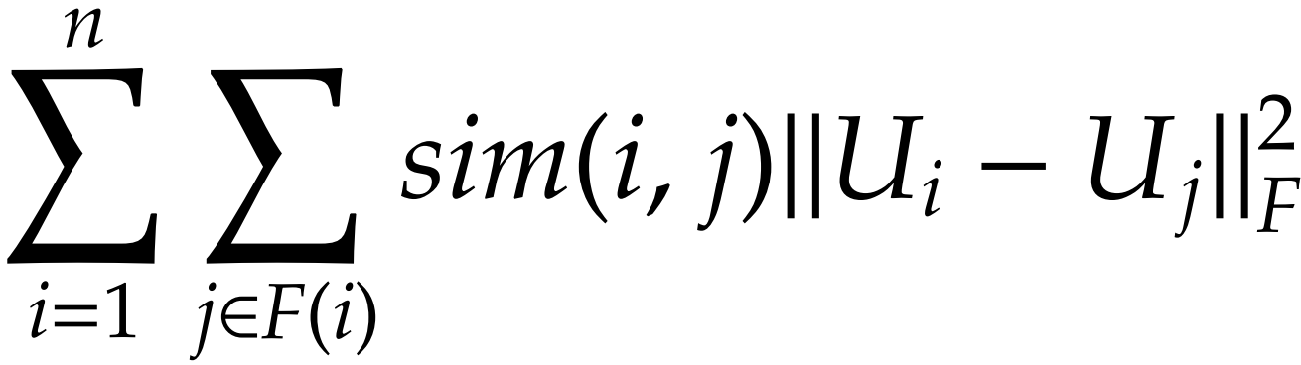
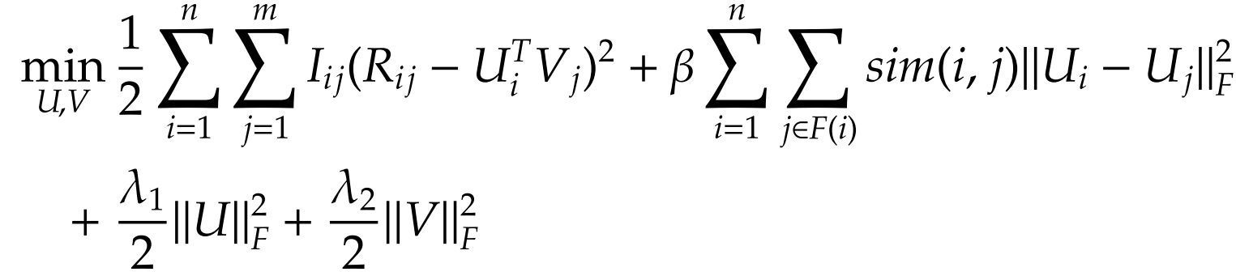
Modeling Social Information in Recommendation
The taste for user i is close to that of all his friends j ∈ F(i)
sim(i, j) denotes the similarity between user i and j (e.g., cosine similarity or Pearson correlation between their ratings) and F(i) denotes the friends of i
Notes:
where β is the constant that controls the eﬀect of social network regularization.
A local minimum for this optimization problem can be obtained using gradient-descent-based approaches. To solve this problem, we can compute the gradient with respect to U_{i}’s and V_{i}’s and perform a gradient descent-based method.

Slide 46
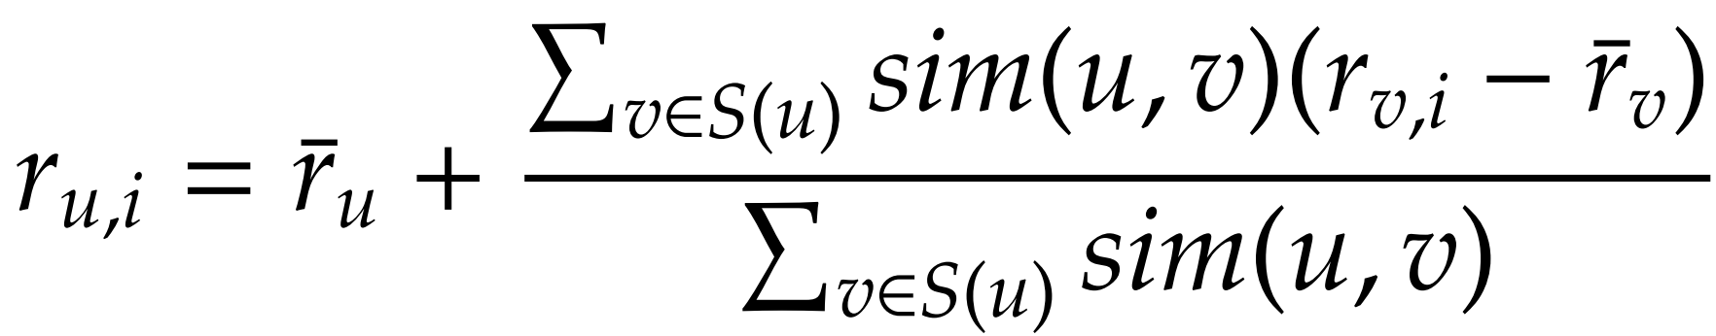
Recommendation Constrained by Social Context
In classical recommendation, to estimate ratings of an item, we determine similar users or items. In other words, any user similar to the individual can contribute to the predicted ratings for the individual.
We can limit the set of individuals that can contribute to the ratings of a user to the set of friends of the user.
S(i) is the set of k most similar friends of an individual

Slide 47
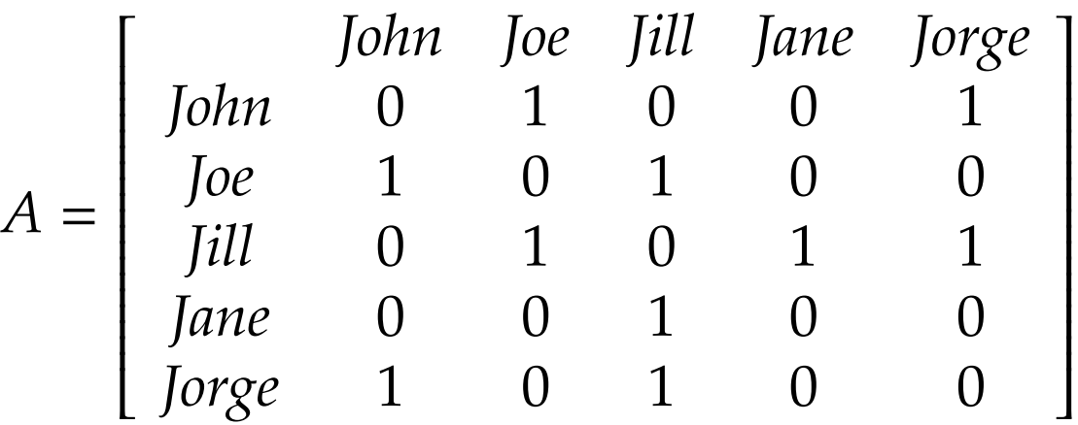
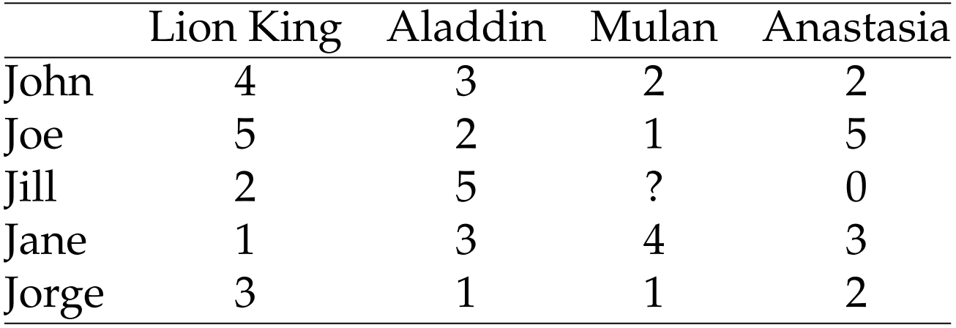
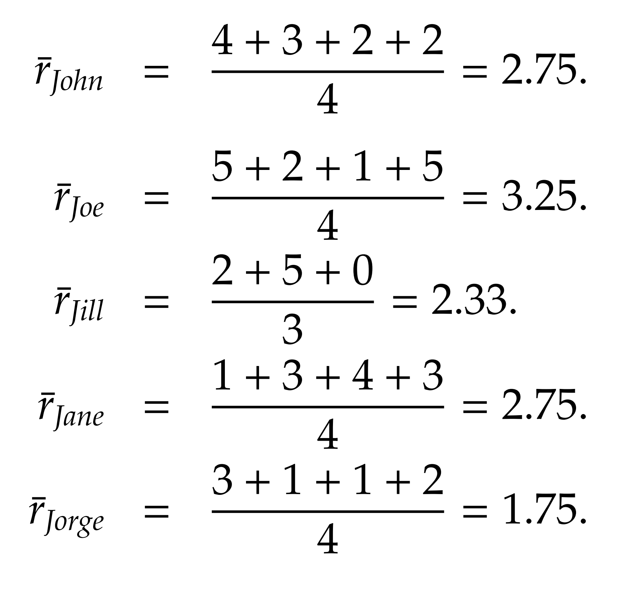
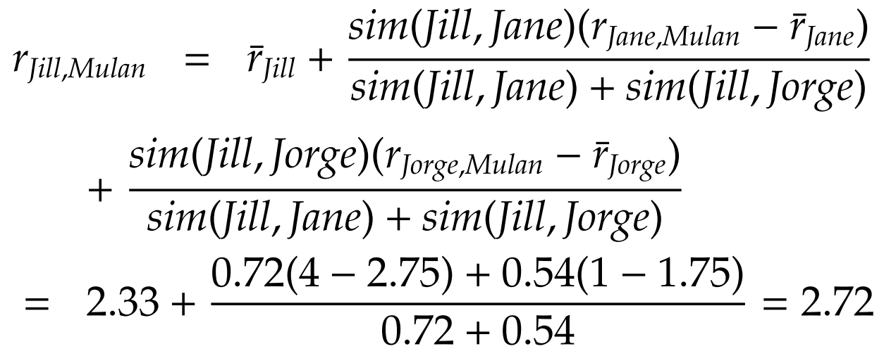
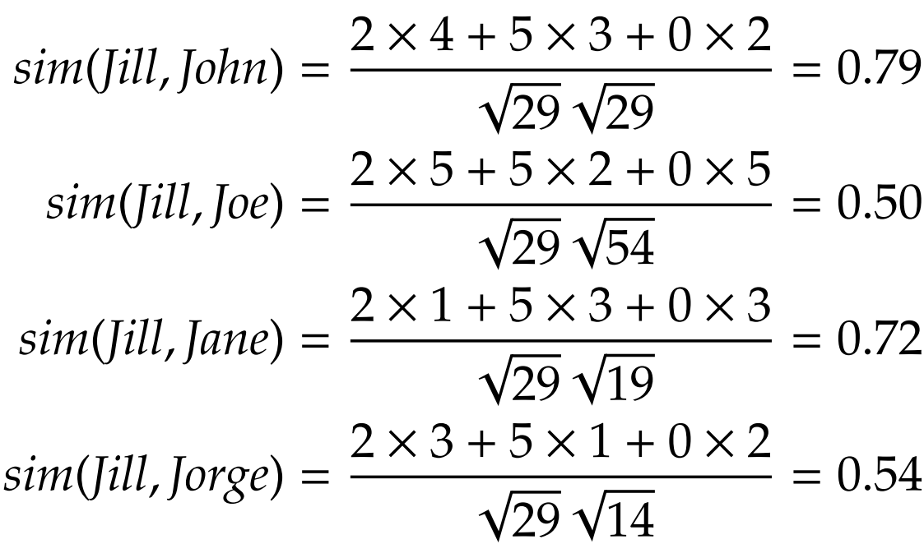
Example
Average ratings
User Similarity
Notes:
Average rating

Slide 48
Evaluation of Recommender Systems

Slide 49
Evaluating Recommender Systems is difficult
Different algorithms may be better or worse on different datasets (applications)
Many algorithms are designed specifically for datasets where there are many more users than items or vice versa. Similar differences exist for rating density, rating scale, and other properties of datasets
The goals to perform evaluation may differ
Early evaluation work focused specifically on the "accuracy" of algorithms in "predicting" withheld ratings.
Other properties different from accuracy also have important effect on user satisfaction and performance
There is a significant challenge in deciding what combination of measures should be used in comparative evaluation

Slide 50
Evaluating Recommender Systems
A myriad of algorithms are proposed, but
Which one is the best in a given application domain?
What are the success factors of different algorithms?
Comparative analysis based on an optimality criterion?
Main questions are:
Is a RS efficient with respect to specific criteria like accuracy, user satisfaction, response time, serendipity, online conversion, ….
Do customers like/buy recommended items?
Do customers buy items they otherwise would have not?
Are they satisfied with a recommendation after purchase?
Notes:
Serendipity
ramp-up efforts

Slide 51
How Do We Evaluate Recommenders
Application outcomes
Add-on sales
Click-through rates
The number of products purchased (and not returned!)
Research measures
User satisfaction
Metrics
To anticipate the above beforehand (offline)

Slide 52
Accuracy Metrics
Predictive accuracy
Predictive accuracy metrics measure how close the recommender system’s predicted ratings are to the true user ratings
Classification accuracy
Classification metrics measure the ratio with which a recommender system makes correct vs. incorrect decisions about whether an item is good.
Classification metrics are thus appropriate for tasks such as Find Good Items when users have binary preferences.
Rank accuracy

Slide 53

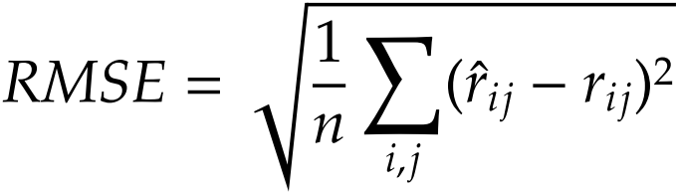
Predictive accuracy - Metrics measure error rate
Mean Absolute Error (MAE) measures the average absolute deviation between a predicted rating (p) and the user’s true rating (r)
NMAE = MAE/(r_{max} – r_{min})
Root Mean Square Error (RMSE) is similar to MAE, but places more emphasis on larger deviation

Slide 54
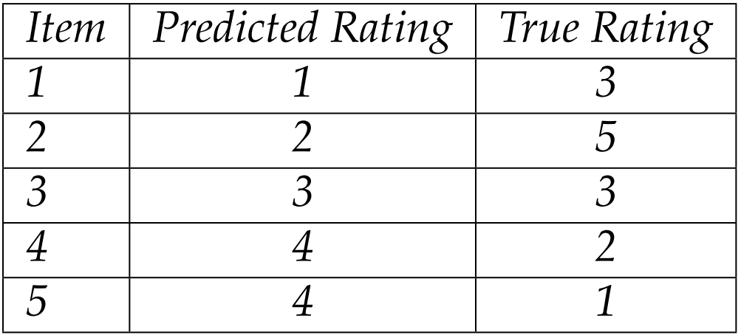
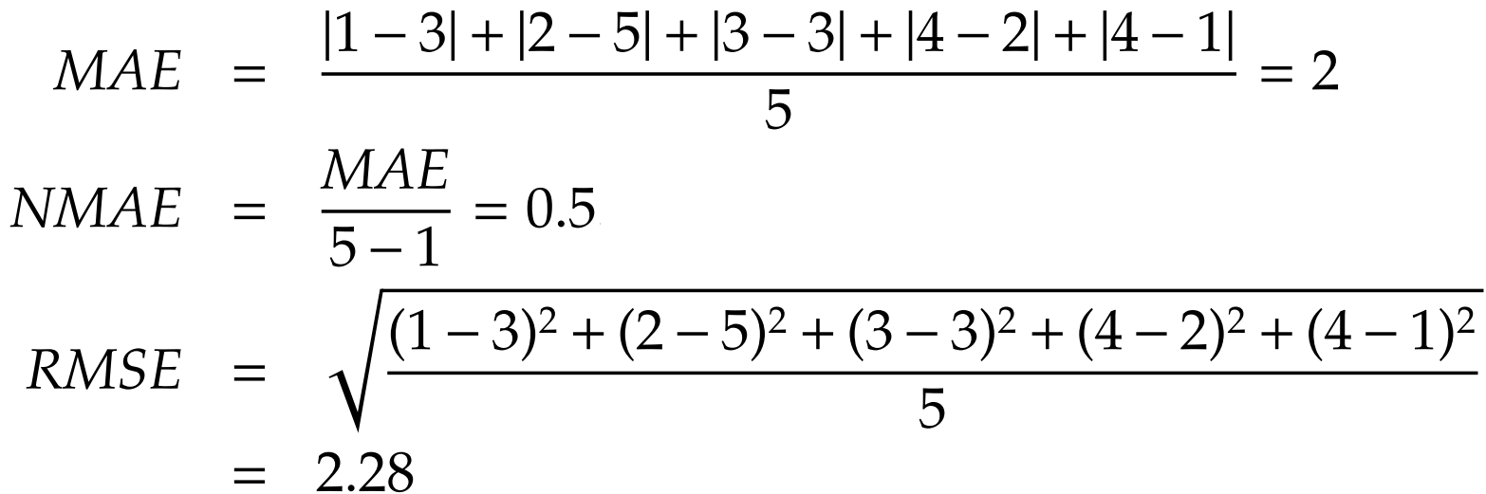
Evaluation, Example
Consider the following table with both the predicted ratings and true ratings of ﬁve items

Slide 55
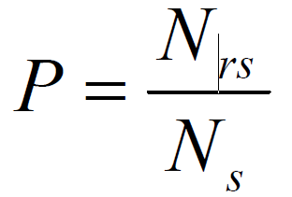
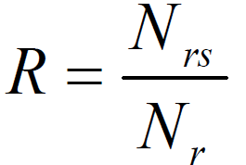

Relevance: Precision and Recall
Precision: a measure of exactness, determines the fraction of relevant items retrieved out of all items retrieved
Recall: a measure of completeness, determines the fraction of relevant items retrieved out of all relevant items

Slide 56


Evaluating Relevancy, Example

Slide 57

Evaluating Ranking of Recommendation
Spearman’s Rank Correlation
$ρ=1− \frac{6\sum_{i=1}^{n}{\left(xi −yi\right)2}}{n3−n}$
Kendall’s $τ$
It checks the concordant the items of the recommended ranking list against the ground truth ranking list
If the two orders are consistent, it is concordant
For top 4 items in ranking list, there are 4*3/2=6 pairs
$τ$ = $\frac{c−d}{\left({n \atop 2}\right)}$
$where c is the number of concordants and d of dis$concordants

Slide 58



Ranking, Example
Consider a set of four items I = {i₁ , i₂ , i₃ , i₄} for which the predicted and true rankings are as follows
Pair of items and their status {concordant/discordant} are

Slide 60
Extra Slides

Slide 61
Beyond Accuracy, Relevance, and Rank
Coverage
Measure of the domain of items in the system over which the system can form predictions or make recommendations
Novelty and Serendipity
Helping users to find a surprisingly interesting item he might not have otherwise discovered
Confidence
How sure is the RS that its recommendation is accurate?
Diversity
Risk
Robustness
Privacy
Adaptivity
Scalability

Slide 62
Content Recommendation in Social Media

Slide 63
Video Recommendation
Related videos defined as videos that a user is likely to watch after having watched a video
Approaches to video recommendation:
Association rule mining
co-visitation

Slide 64

Video Recommendation: Association Rule Mining
System calculates the probability of watching v_{j} after the user watched v_{i} and recommends top-N of highly ranked videos
Notes:
This is basically a measure called Confidence

Slide 65

Video Recommendation: Co-visitation
Co-visitation score is a number that shows in a given time period, how often two videos co-watched within sessions
c_{ij} is the number of co-watches for videos v_{i} and v_{j} and f (v_{i}, v_{j}) is a normalization factor regarding the popularity of two videos, e.g., e the product of the videos’ popularity (the number of views).
Notes:
A video’s popularity is its number of views.

Slide 66
Tag Recommendation
Tag recommendation is the process of recommending appropriate tags to be applied by the user per specific item annotation
Approaches:
Recommending the most popular tags
Collaborative Filtering
Content-based Tag Recommendation
Graph-based

Slide 67
Tag Recommendation: Popularity-based and CF Approaches
Recommend the most popular tags
Popular tags already assigned for the target item
Frequent tags previously used by the user, and
Tags co-occurred with already assigned tags.
Collaborative filtering
It can use item-based or user-based approaches.
Or it may use a hybrid approach by recommending tags given by similar users to similar items.

Slide 68
Tag Recommendation: Content- and Graph-based Approaches
Content-based Tag Recommendation
This can be done by recommending keywords from the item’s associated text or tags that have the highest co-occurrence with important keywords.
Graph-based Approaches
The FolkRank algorithm is an example. Its idea is: a resource which is tagged with tags by important users should be important.

Slide 69
News Recommendation
A recommended news should be of interest to the user if it is recent or fresh, diverse, and not very similar (the same) to the other news the user recently read.
Regular recommender systems might not be used for news as recency is one of the most important factors for a piece of news.

Slide 70
Blog Recommendation
The blog recommendation is the task of finding relevant blogs in response to a query
Blog relevance ranking differs from classical document retrieval and ranking in several ways:
How to deal with blog posts
How to come up with reliable queries as user queries represent current interests in the topic

Slide 71
Blog Recommendation: An Algorithm
A solution for the first problem is using two different document models
Large document model: entire blog as a whole
Small document model: each blog post as a document.
The second problem can be solved by query expansion
Query Expansion (QE) is the process of reformulating a seed query to improve retrieval performance in information retrieval operations).
Using wikipedia is an often used method for query expansion: the query is sent to Wikipedia, and the retrieved wiki articles are now new queries and will be used for blog searching.
After solving these two problems of blogs, we can use existing recommendation systems to get the blog recommendation.

Slide 72
Social Media Content Recommendation: Tag Based
People use tags to summarize, remember, and organize information.
Tags are a powerful tool for social navigation, helping people to share and discover new information contributed by other community members.
Tags promote social navigation by their vocabulary, or the set of tags used by members of the community.
Instead of imposing controlled vocabulary or categories, tagging systems’ vocabulary emerges organically from the tags chosen or created by individual members.
A tag-based recommendation system uses tags to recommend items.

Slide 73
Tag Based Recommendation
Algorithms combining tags with recommenders provide both the automation inherent in recommenders, and the ﬂexibility and conceptual comprehensibility inherent in the tagging system.

Slide 74
Hybrid Approaches to Recommendation

Slide 75
Pipeline hybridization
This approach uses more than one recommender system and puts the recommender systems in a line.
The result of one recommender is the input for another one.
The earlier recommender can make a model of the input and pass it to the next recommender system or can generate a list of recommendations to be used by the next recommender system.

Slide 76
Parallelized hybridization
We use more than one recommender algorithm.
The hybridization process gets the result of recommenders, combines them and generates the final recommendation.
Different methods can be used to combine the results of other recommenders such as:
Mixed (a union of results from all recommender systems),
Weighted (a weighted combination of the results),
Switching (use results from specific recommender systems for specific tasks),
Majority voting.

Slide 77
Recommendation Explanation
The digital camera X is the best for you because …

Slide 78
Confidence
Why would someone distrust a recommendation?
Can I trust the provider?
How does this work, anyway?
Does the system know enough about me?
Does the system know enough about the item it is recommending?
How sure is it?

Slide 79
The Confidence Challenge
Why should users believe recommendations?
When should users believe them?
Approaches
Confidence indicators
Explain the recommendations
Reveal data and processes
Corroborating data, track records
Offer opportunities to correct mistaken data

Slide 80
Explanations in recommender systems
Motivation
"The digital camera Profishot is a must-buy for you because . . . ."
Why should recommender systems should deal with explanations at all?
The answer is related to the two parties providing and receiving recommendations:
A selling agent may be interested in promoting particular products
A buying agent is concerned about making the right buying decision
Additional information to explain the system`s output following some objectives

Slide 81
Objectives of explanations
Transparency
Provide information such that the user can comprehend the reasoning used to generate a specific recommendation
Validity
Explanations can be generated in order to allow a user to check the validity of a recommendation
Trustworthiness
Explanations aiming to build trust in recommendations reduce the uncertainty about the quality of a recommendation
Comprehensibility
Explanations targeting comprehension support the user by relating her known concepts to the concepts employed by the recommender
Education
Deep knowledge about the domain helps the customer rethink her preferences and evaluate the pros and cons of different solutions

Slide 82
Objectives of explanations
Persuasiveness
In this sense persuasive explanations for recommendations aim to change the user's buying behavior
Effectiveness
The support a user receives for making high-quality decisions
Efficiency
A system's ability to support users in order to reduce the decision-making effort e.g. time
Satisfaction
Explanations can attempt to improve the overall satisfaction stemming from the use of a recommender system.
Relevance
Additional information may be required in conversational recommenders. Explanations can be provided to justify why additional information is needed from the user

Slide 83



Examples
Similarity between items
Similarity between users
Tags
Tag relevance (for items)
Tag preference (of users)

Slide 84
Explanation types
Nearest neighbor explanation
Customers who bought item X also bought items Y,Z
Item Y is recommended because you rated related item X
Content based explanation
This story deals with topics X,Y which belong to your topic of interest
Social-network based explanation
People leverage their social network to reach information and make use of trust relationships to filter information.
Your friend X wrote that blog
50% of your friends liked this item (while only 5% disliked it)

